Slide 1
Module III Chemical Thermodynamics
Dr. Jayanthy S. Panicker

Slide 2
Fundamentals. First law of thermodynamics. Molecular interpretation of internal energy, enthalpy and entropy. Heat of reaction. Kirchoff’s equations. Dependence on pressure and temperature. Gibbs-Helmholtz equation. Free energy changes and equilibrium constant. Chemical potential and fugacity. Thermodynamics of biochemical reactions.

Slide 3
What is Thermodynamics?
The science of energy, that concerned with the ways in which energy is stored within a body.
Energy transformations – mostly involve heat and work movements.
The Fundamental law is the conservation of energy principle: energy cannot be created or destroyed, but can only be transformed from one form to another.

Slide 4
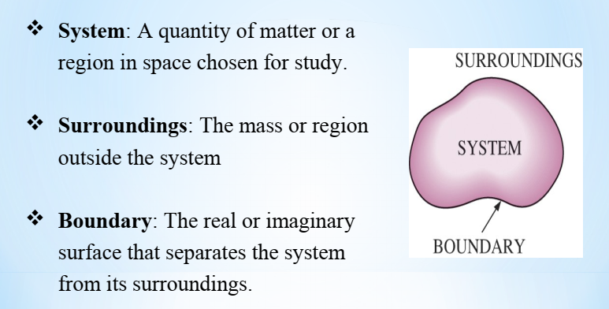
System, surroundings and boundary

Slide 5
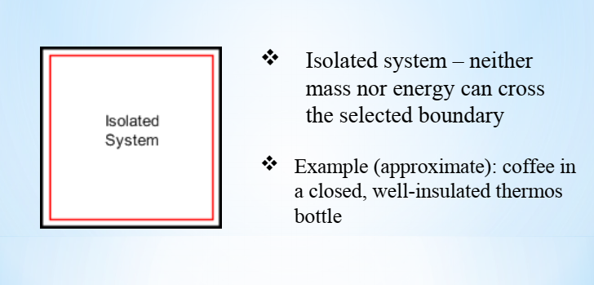
Types of system
Isolated system

Slide 6
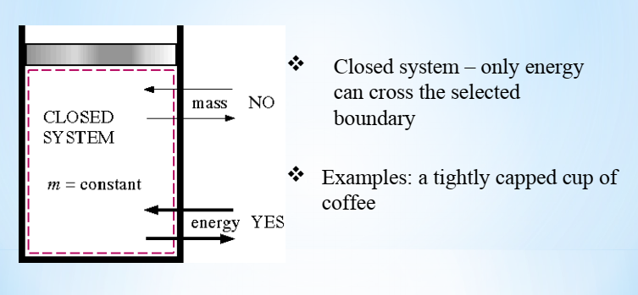
Types of system
Closed system

Slide 7
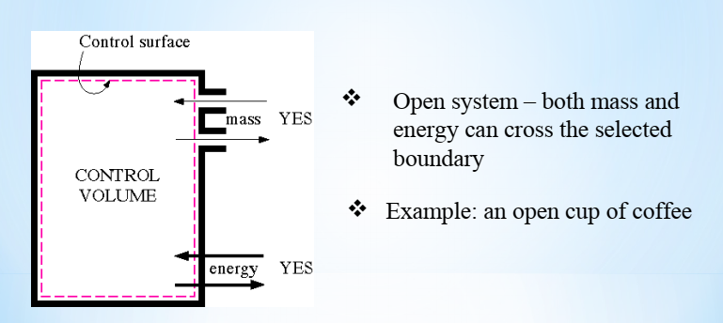
Types of system
Open system

Slide 8
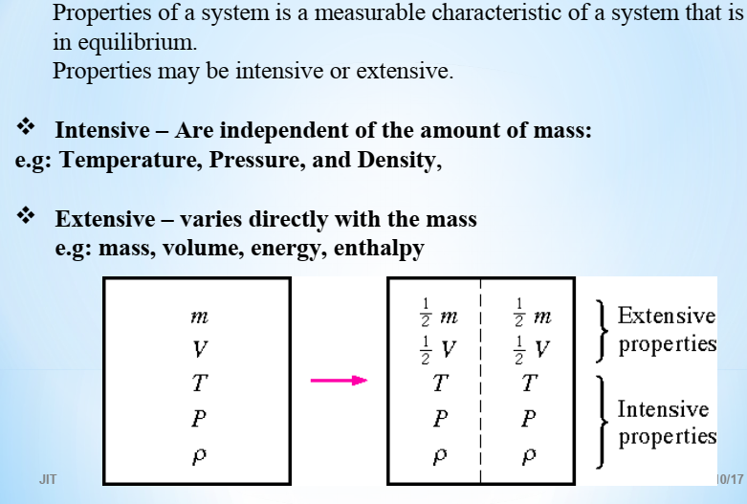
Properties of a system

Slide 9
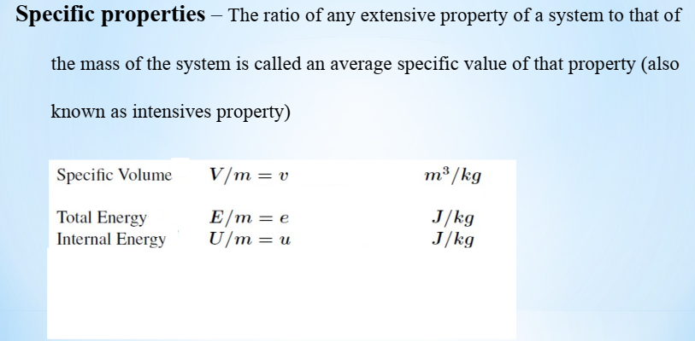
Properties of a system

Slide 10
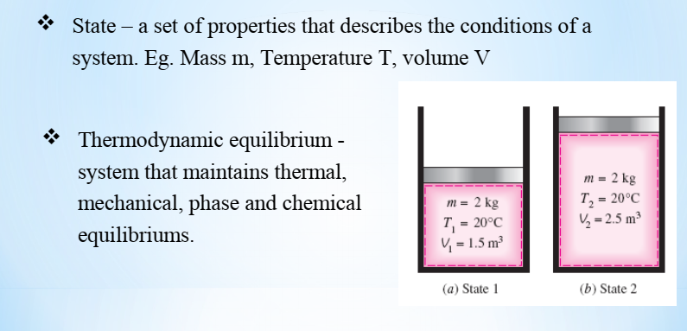
State, Equilibrium and Process

Slide 11
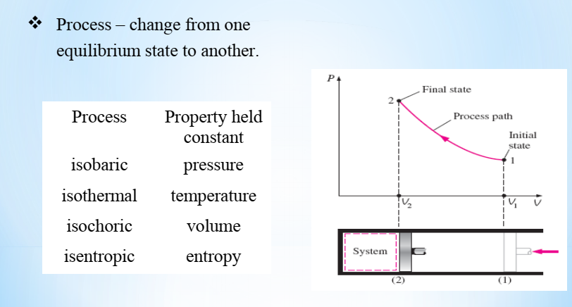
State, Equilibrium and Process

Slide 12
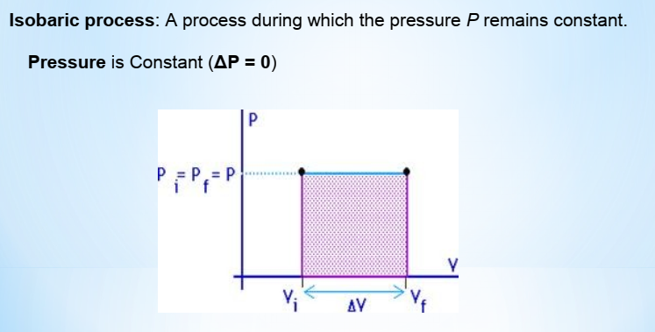
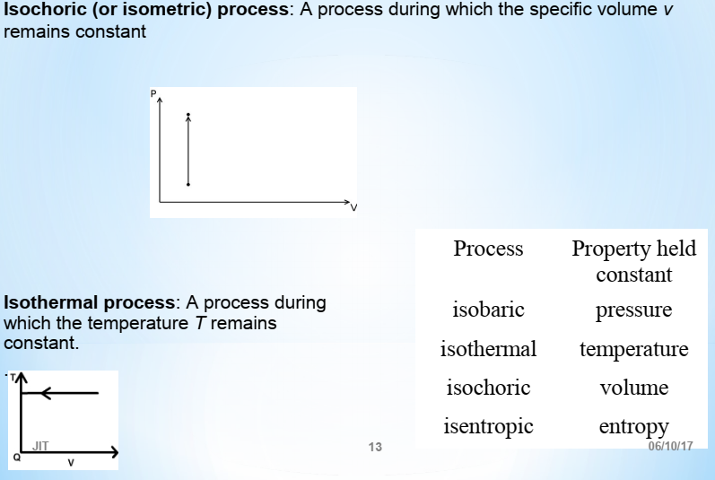

Slide 13
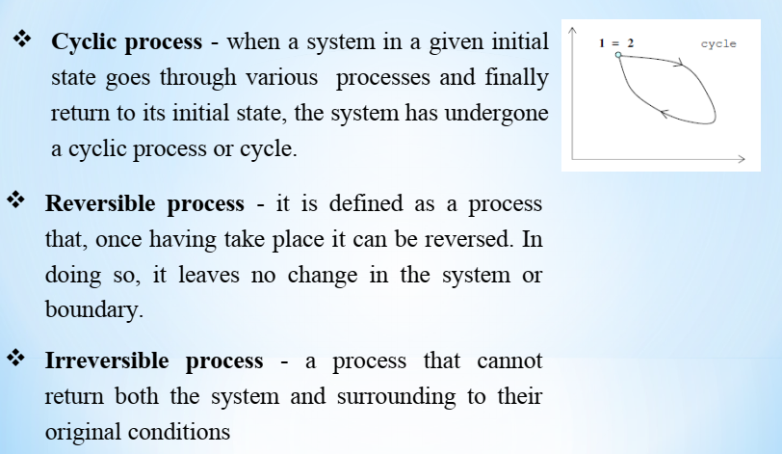
Types of Thermodynamics Processes

Slide 14
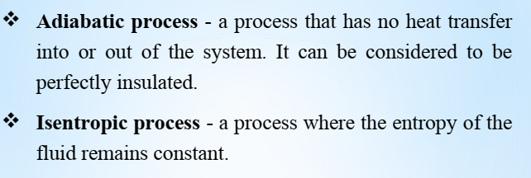
Types of Thermodynamics Processes

Slide 15
Laws of Thermodynamics
The generalized laws of thermodynamics are
Zeroth law of thermodynamics states that if two systems are in thermal equilibrium with a third system then they are in thermal equilibrium with each other
First law of the conservation of energy which represents the connection between heat and mechanical work.
Second law deals with the entropy change in the system and the manner in which energy change takes place.
Third law deals with the absolute value of entropy.

Slide 16
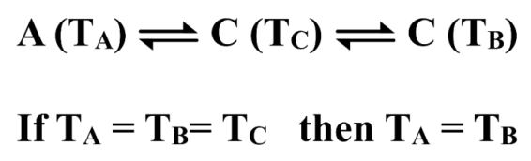
Zeroth law of Thermodynamics
zeroth law of thermodynamics was formulated after first law of thermodynamics but was of primary importance thus called Zeroth law.
This law states that if two systems are in thermal equilibrium with a third system then they are in thermal equilibrium with each other i.e. if body A is in equilibrium with body C and body B is also in equilibrium with body C, then both the bodies are in equilibrium with each other. In other words if systems A and B are placed in contact with each other, then no exchange of heat will take place.
The use of thermometer is based on this principle.

Slide 17
First law of Thermodynamics
The first law of thermodynamics deals with the relation between the change in the energy with work and heat.
This law is also known as the law of conservation of energy.
“Energy can neither be created nor destroyed, although it can transformed from one from to another.”
Energy can be produced by the destruction of mass, the two quantities being
related by the expression E = mc² (Einstein Equation).
Modified Law: The total mass and energy of an isolated system remains unchanged.

Slide 18
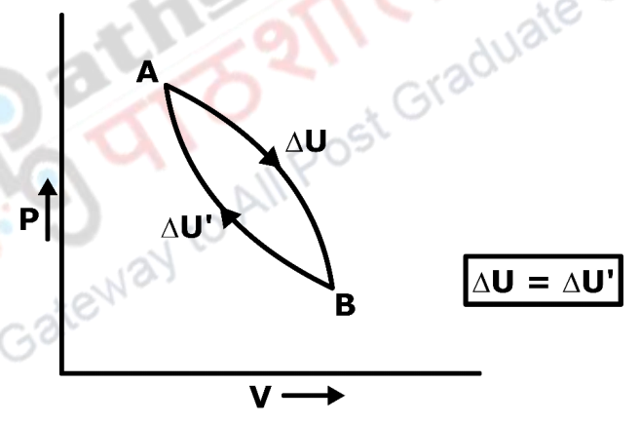
Mathematical Formulation of the First Law of Thermodynamics
Suppose a system is subjected to change of pressure and volume, let initial state
be A and find state represented as B.

Slide 19
Internal Energy
A definite amount of energy which is present in every substance that depends upon its chemical nature as well as upon its temperature, pressure and volume. This energy is known as internal energy.
The chemical nature includes such indeterminant factors as the translational, rotational and vibrational movements of the molecules, the manner in which the molecules are put together, the nature of the individual atoms, the arrangement and number of electrons, the energy possessed by the nucleus etc. therefore, exact magnitude of the energy is not known.
Internal energy of a substance or a system is a definite quantity and it is a function only of the state (i.e., chemical nature, composition, temperature, pressure and volume) of the system at the given moment, irrespective of the manner in which that state has been reached.
.

Slide 20
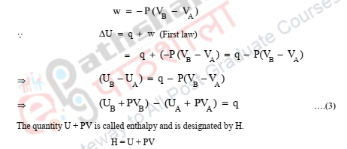
Enthalpy
Let change of state of a system is brought about at constant P and there will be a change in Volume (V).

Slide 21


